Slide 1

Classical Solution for Real-World Supply Chain Route Optimization
A step-by-step guide using Python and Google OR-Tools to solve complex routing problems with real-world constraints.
AION OS

Slide 2

Project Overview
This project develops and compares classical and quantum solutions for real-world supply chain route optimization. The first phase creates a robust classical benchmark using Google's OR-Tools library.
This solution serves as the definitive baseline for evaluating future quantum algorithms against industry-standard optimization techniques.
AION OS

Slide 3




The CVRPTW Problem
Capacitated Vehicle Routing Problem with Time Windows
Single Depot
N Customers
Central warehouse where all vehicles start and end routes
Locations to be served, each with specific demand for goods
K Vehicles
Fleet with known maximum cargo capacity
AION OS

Slide 4
Constraints & Objectives
01
02
Minimize Total Distance
Complete Service
Find routes that minimize total distance traveled by all vehicles
Every customer visited exactly once by one vehicle
03
04
Depot Return
Capacity Constraint
All routes start and end at the depot
Total demand per route cannot exceed vehicle capacity
05
06
Time Windows
Service & Operating Time
Customers served within specified time windows
Fixed unloading time and maximum vehicle operating hours
AION OS

Slide 5

Real-World Scenario: New Delhi Logistics
The Setup
Depot: Connaught Place
Customers: 10 landmarks across the city
Vehicles: 3 trucks, each with 15-unit capacity
Operating Hours: 8:00 AM - 5:00 PM
AION OS
Using actual locations in New Delhi, India to create a realistic optimization scenario that mirrors real-world logistics challenges.

Slide 6
Customer Locations & Demands
Location
Coordinates
Demand
Time Window
India Gate
28.6129, 77.2295
1 unit
9:00-10:00 AM
Red Fort
28.6562, 77.2410
1 unit
11:00 AM-12:00 PM
Qutub Minar
28.5245, 77.1855
2 units
1:00-2:00 PM
Lotus Temple
28.5535, 77.2588
4 units
1:00-2:00 PM
Khan Market
28.5940, 77.2225
8 units
9:00-10:00 AM
Akshardham
28.4744, 77.5026
8 units
12:00-1:00 PM
AION OS

Slide 7



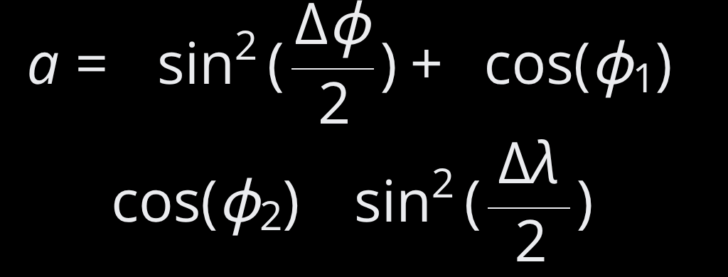


The Haversine Formula
Calculating Real-World Distances
The Haversine formula accounts for Earth's curvature to calculate accurate distances between geographic coordinates.
Step 1
Step 2
Step 3
Calculate intermediate value a
Calculate intermediate value c
Calculate final distance d
Where R ≈ 6,371 km (Earth's radius)
AION OS

Slide 8
Solution Outputs
Console Summary
Interactive HTML Map
Detailed route for each vehicle with order of stops, cumulative load, and precise arrival times ensuring all time windows are respected.
Visual display of optimized routes on a map of New Delhi (delhi_routes_map_final.html), showing the complete delivery network.
AION OS

Slide 9
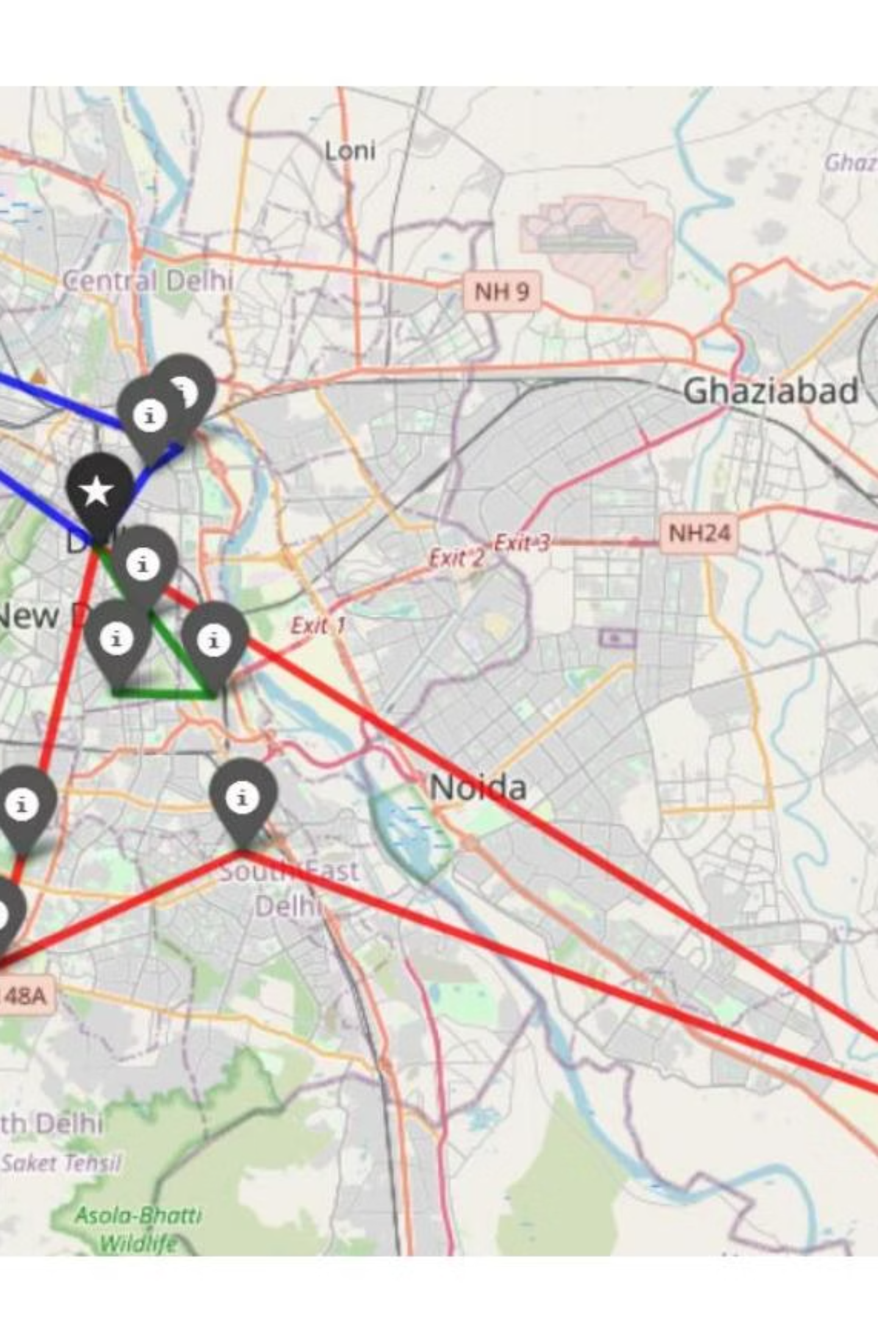
Optimized Route Visualization
The map displays three optimized vehicle routes across New Delhi, each color-coded to show efficient paths that respect capacity constraints, time windows, and minimize total distance traveled.
AION OS

Slide 10
Results and Next Steps
Classical Solution Complete
3
10
This optimized solution is verifiable and respects all complex, real-world constraints. It forms the perfect, high-quality benchmark for the next phase.
Vehicles
Customers
The definitive baseline for quantum algorithm evaluation
Optimized fleet deployment
All served within time windows
100%
Constraints Met
Capacity and time respected
Next phase: Tackling the same problem with quantum computing algorithms to compare performance against this classical benchmark.
AION OS

